Slide 1
Return On reputation
Position
Paper
Brought to you by
Martine Degreef
& Dominique Vanmarsenille

Slide 2
Contents
What is corporate reputation about?
Who are the stakeholders that build reputation?
What drives corporate reputation?
How b²sense’s Corporate Reputation Model is set up
How does a typical questionnaire look like?
What kind of deliverables can you expect?
You cannot really manage reputation in today's interconnected and hyper-transparent world, but you can influence it
In order to influence it, you first need to measure reputation
Open and faithful communication is key to tell your story in a positive light
Be authentic and walk the talk to build trust in case something goes wrong
Listen to the priorities and expectations from all stakeholders because they may prioritise differently
Prioritise your stakeholders so that you can focus on those with the greatest impact on reputation
Reflect on your role in society and honour this responsibility in word and deed

Slide 3
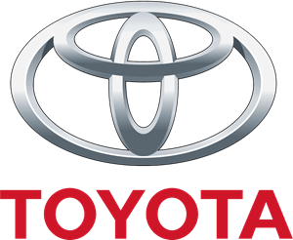
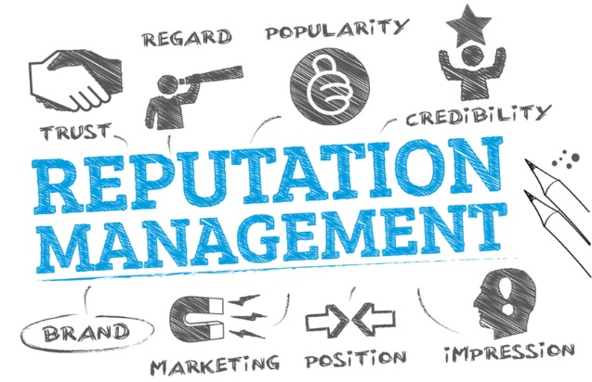
CORPORATE REPUTATION
What is corporate reputation about?
A good corporate reputation is recognised as a vital asset with a real impact on your company’s success and value; this includes your bottom line. The reverse is true for a bad reputation with financials costs and tumbling share price. A good reputation can also help you to uphold the company’s value when disaster strikes.
Toyota has been in pole position in terms of consumer trust for ages with its excellent reputation for quality, safety and reliability.
Toyota would not have remained among the most admired companies and share price would have tumbled, had it entered into its period of regular recalls without its reputational capital
It is said that corporate reputation accounts for 1/3 of the total capitalisation of the world’s top stock marked indices, growing to more than 50% for companies such as Apple¹.
Corporate reputation is basically how your company is perceived by others over time, in terms of finances, social responsibility, sustainability and many more drivers.
Brand image can or will constitute one of these drivers, but is not the same as corporate reputation. Image can be built from marketing and communication. Reputation is a more complex and long- term metric.
Corporate reputation is built by multiple stakeholders with a growing interconnectivity. Hyper transparency makes that bad news will travel at hyper speed across all stakeholders. It is key that you measure corporate reputation value for each of these stakeholders and understand what drives this value. Bear in mind that different stakeholders have different concerns and needs. Investing in a robotized factory and laying off staff can be good news for investors, but employees and unions will see this otherwise.
Building a strong reputation is about consistently doing what you say you are going to do and less about doing the right think or even about saying the right things.

Slide 4
CORPORATE REPUTATION
Who are the stakeholders that build reputation?
Reputation lies in the eye of the stakeholder; hence your company will have multiple reputations. Different stakeholders can be affected by different events and form their opinions of your company on how you deal with these events.
Companies with a consistent alignment to specific stakeholders often benefit from a strong corporate reputation. This is why …
A tobacco company can have a good reputation among investors seeking stability, whilst few consumers will consider that same company as reputable
The consumer is the primary stakeholder of Amazon with whom they want to score high.
We identified the following key-stakeholders. Each of these can influence the perceptions of other stakeholders in today’s interconnected world. Hence, a holistic approach is required.
Employees & Future talents
Investors
Think tanks & NGO’s
Category buyers
Opinion makers incl. media
Government & Policy Makers
Local Communities
Must have
Optional Special Targets
When measuring your corporate reputation, all stakeholders should be represented in the sample but the focus will most often lie on customers, prospects and employees because it is expected that they have the most immediate and pivotal impact on your business performance.

Slide 5
CORPORATE REPUTATION
Stakeholder | What does it bring? | Proof¹
Category Buyers | Larger customer base through increased share of wallet and advocacy Customers pay a premium price Longer lifetime value Enhanced profile on social media. | Positive reviews make 9/10 consumers more likely to use a business 9/10 consumers would boycott a company with irresponsible or deceptive business practices.
Employees & Future Talents | More applicants Broader talent pool Attraction of top talent Increased employee retention Proud staff to work there Increased motivation. | Reputation is important to 8/10 jobseekers and 5/10 would not work for a company with a bad reputation.
Opinion Makers | Avoid negative reporting or shorten bad news cycles Build public rapport Free publicity Opportunities to provide expert comment Stronger media coverage. | Brands with negative stories appeared in nearly twice as many headlines and were shared nearly twice as much on social media than positive stories.
Investors | Better access to capital markets Attracting investors willing to face greater risks or lower return Better share performance versus others Increased investor loyalty and advocacy. | Corporate reputation accounted for 1/3 of total capatilisation of the world’s top 15 stock market indices, representing over 15 trillion Euro in shareholder value.
Government & Policy Makers | Less scrutiny Reduced regulatory burden Preferential access to (future) projects Influence on policy formation Greater openness for dialogue. | 7/10 of regulatory compliance professionals in financial institutions see protecting their corporate reputation as their primary role 9/10 of the largest global companies are concerned about news coverage of how much tax they pay.
Think tanks & NGO’s | Raised public profile Positive media coverage Avoiding negative campaigns Broader networking Recruiting advantage Access to new sectors Impact on industry research. | 9/10 UK consumers think businesses should support charities and local communities 6/10 UK consider that companies that do so benefit from increased profits.
Local Communities | Attract and retain local talent Appeals to customers Boosts local economy Gain competitive advantage through community promotions Links with community leaders Gain support for business expansion | 8/10 consumers would buy a product from an unknown brand if it had strong social commitments 9/10 US employees believe that companies who sponsor volunteer activities offer a better working environment
¹ Alva-Group.com

Slide 6
CORPORATE REPUTATION
Quick Tips
Each target group should be representative for its population.
For the must-have target groups, we recommend to draw a large enough sample, allowing for robust statistical analyses, and comprising all relevant subgroups, you wish to analyse the results for.
When drawing the category-users-sample for example, you must make sure that you sample a sufficient number of customers and prospects, a sufficient number of smaller and larger businesses or younger and older consumers, recent customers, churners, etc.
The same goes for the employees, where all levels, functions, divisions, age categories, etc. need to be represented.
For the optional targets, we advice to have a minimum of 10 to 20 interviews for each subgroup. This will allow you to analyse their feedback separately but in general, the optional targets are regrouped in the analyses and confronted with the category users and employees as a whole.
When talking to these stakeholders, especially the special target groups and future talents, we must make sure that they know the brand or company that we wish them to evaluate. For example, they should know which products or services the brand offers (if only one) and which other brands, the brand competes with (if only one). Only then, we are sure that we obtain an informed judgement and hence reliable information.

Slide 7
CORPORATE REPUTATION
What drives corporate reputation?
It is vital to track what drives reputation, because this will assist you to forecast, anticipate and respond to reputation-endangering events effectively.
Reputation lies in the eye of the stakeholder; hence your company will have multiple reputations. Different stakeholders can be affected by different events.
Based on extensive research, we identified 10 drivers of corporate reputation:
Product & Service Culture Quality
Employment Attractiveness
Transparency
Leadership Quality
Business Performance
Innovation
Ethical Business Practice
Social Responsibility
Other Relevant aspects
Marketing & Sales Effective- ness
Sustainability
Please find a few examples of how these drivers are converted into statements
to evaluate your brand’s reputation on the next page.
Important remarks:
Each driver can be in a different stage of it’s life-cycle … emerging, current or inactive
Reputation is organic, hence you must make sure that they reflect the changing priorities of the stakeholders
It is vital to determine the weight of each driver for each stakeholder in order to focus your resources on the most critical drivers

Slide 8
CORPORATE REPUTATION
Leadership Quality
Competent management with a clear vision for the future
Has a strong and appealing leader
Employment Attractiveness
Is a great place to work
Rewards employees fairly
Business Performance
Is a profitable company
Has strong prospects for the future
Ethical Business Practice
Is fair in the way it does business
Operates in an ethical way
Product & Service Culture Quality
Has a high-quality portfolio of products and services
Its offering is in line with the needs of the customers
Transparency
Communicates in an open and transparent way Is open and honest
Marketing & Sales Effective- ness
Efforts in sales and marketing lead to business growth
Has a clear strategy and goal in mind
Social Responsibility
Put a lot of effort to contribute to an inclusive society
It operates in a way that benefit society
Innovation
Is an innovative company
Is a company that adapts to change quickly
Sustainability
Is an environmentally responsible company (wise resource use, reduce emissions, prevent pollution and waste, and reduce energy use).
Other Relevant aspects
To be developed based on the mission and vision of the company

Slide 9
CORPORATE REPUTATION
How b²sense’s Corporate Reputation model is set up
Behavior is impacted by decision makers’ level of trust in the brand, which in turn is powered by the brand’s reputation versus its generic and non-generic competitors
Reputation
Your brand versus (non-)generic competition
Trust
Behavior
RoR
Return on Reputation
Here we evaluate all relevant reputational aspects of your brand and its generic and non- generic competitors
Your reputation fuels trust in your brand. Decision makers see your brand as reliable, honest, competent and credible.
Trust convinces decision makers to buy your brand and incite others to do SO.
Beware: Corporate reputation is more than just image. Image can be built from marketing and communication. Reputation is a more complex and long-term metric.

Slide 10
CORPORATE REPUTATION
What does a typical questionnaire look like?
A typical reputation-questionnaire for category users contains the following sections:
Profile
Profile of the company/household
Profile of the decision maker
Possibly screening questions to exclude non-relevant respondents (category usage, familiarity with the brand, age, ...)
Market Structure
Which brand(s) stand out or is this a commodity market?
What motivates their choice?
Behavior
Usage frequency
Purchase intentions
Reputation
Evaluation of the brand and its generic and non-generic competitors on relevant reputational aspects
Brand Health
Preference
Commitment
Net Promoter Score (recommendation)
Trust
Overall level of trust
Relevant drivers of trust: reliability, honesty, competence, credibility
The questionnaire content will be adapted to each stakeholder and customized to each client’s individual situation and needs.

Slide 11
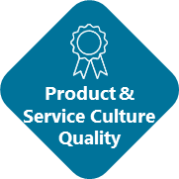
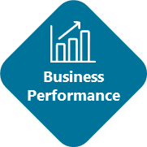
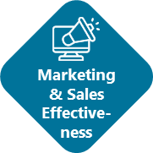
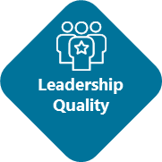
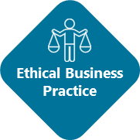
CORPORATE REPUTATION
What kind of deliverables
can you expect?
Which are the REPUTATION key attributes to focus on in order to increase TRUST?
Among all stakeholders, employees, potential employees, prospects….
Develop action plans and translate the insights in targeted communication plans
High
High Priority
Improvement Areas
High Impact Leverages
Impact of the REPUTATION attributes
on TRUST
Secondary
Improvement Areas
Low Impact Leverages
Low
Poor
Excellent
Performance of your company on the REPUTATION attributes

Slide 12
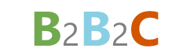
Our Mission
Our Vision for the future
We foster a caring spirit and a result-driven objective: to deliver impactful insights via a tailored research approach aimed at easing our clients’ business challenges beyond the operational level. Via inventive solutions, vast multi-sector experience and a drive for efficiency we continue to meet the evolving expectations of local and global business communities of tomorrow.
Because when people thrive, so do their businesses.
To become the go-to-reference for resolving challenging queries across the customer chain, for both local & global businesses through inventive research and impactful insights.
With end-consumers playing an increasingly important part, the need for integrated b2b and b2c research is on the rise. Our roots in b2b research combined with our capabilities in end-user and consumer research means we can help our clients with any b2b2c requirements.
Our research team brings a wealth of methodological- and sector expertise in Brand, Customer experience, Innovation as well as market opportunities. Combined with an inventive and forward-thinking approach, it is important to us to think with our clients and find solutions that work for them.
Via our in-house call center and our extensive eco-system of local and global research partners, we can cover any type of research in just about any market that our clients require.
We work as part of a larger community where like-minded partners like Minds&More and links with academic communities provide additional tools and opportunities to stay up to date with, teach and make sense of our business and social environments.
Our enthusiastic team built legion experience in numerous industrial and services sectors. We know how to reach the relevant target groups and retrieve relevant insights, using our own data-collection capabilities and trusted fieldwork partners and applying research methods and models, aligned to target groups in each country.
Building & construction
Business services
Energy
Food
Finance & insurance
Health Wellbeing
Industry & Technology
Telecom & ICT
Transport & Logistics
Our DNA leads to satisfied advocates
Connect
Understand your challenges business issues and needs for insights
90%
90%
Customize
Blank page approach, identifying the best solution to your problem. Sharing our experience and expertise
Satisfied clients
Of our clients is (very) likely to recommend us
Commit
Senior project management team with pro-active, can-do and “team” attitude, committing to full customer satisfaction
Airport Plaza Campus
Leonardo da Vincilaan 19A box 8
1831 Diegem
www.b2sense.com
Position paper
©b²sense 12
Notes:
b²sense is een jong bedrijf … wij zijn actief sedert 1 jan 2021 … dat ontstond uit een management buy out van Kynetec met als core team 5 ervaren marktonderzoekers die reeds meer dan 15 jaar samenwerken.
Misschien eerst iets over onze naam…
b² refereert naar onze BtoB legacy maar 1/3 van onze activiteit bestaat uit BtoC onderzoek.
Sense refereert naar observeren, ontdekken, leren, begrijpen … dat is wat wij doen, maar het refereert ook naar ”making sense” of wat het resultaat is van wat wij doen.
Research & More refereert naar “more than just research” … wij dragen zorg voor het gehele onderzoekstraject en trachten dit zo gemakkelijk mogelijk voor u te maken … te ontzorgen, wij weten met wie we moeten converseren, welke vragen we aan wie moeten stellen, hoe wij de behoeften en percepties van klanten en prospects in kaart moeten brengen. Research & More verwijst ook naar Minds & More als 6de aandeelhouder van b²sense. 

Slide 13
About the Author
Martine is a passionate senior consultant with a wealth of experience in all types of research. Today she focusses mainly on large international business to business projects. Her career resulted in a thorough knowledge of the market research practice may it be qualitative as well as quantitative.
At the start of every project, even after more than 30 years, Martine is still curious about the findings and insights, this curiosity drives her to gather valid answers to the questions of businesses and translate them into actionable recommendations.
Setting up market research tailored to a company's capabilities and translating insights from research into marketing and communication plans is her strong suit. Her expertise lies in conceptualizing and elaborating research projects that yield strategic marketing insights.
The projects that are close to Martine's heart are in the field of innovation; recognizing needs and expectations of decision-makers in order to help develop new products and services that meet market expectations. Outside innovation processes, Martine likes to be involved in projects that map the performance of brands in order to establish high-performance brands in the market.
MARTINE DEGREEF
Managing Partner at b²sense
martine.degreef@b2sense.com
Text
https://linkedin.com/in/martinedegreef

Slide 14
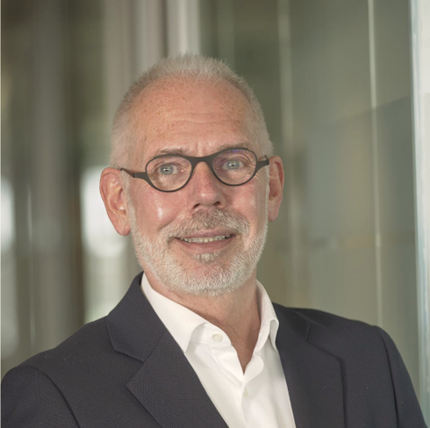
About the Author
Based in Belgium, Dominique is a founding member of b²sense after a management buy out from Kynetec. With more than 35 years’ experience in BtoC- and BtoB-market research, Dominique is widely experienced in domestic and international market research working for many reputable companies across a wide range of sectors.
Dominique is a marketer and researcher with a wide spectrum of interests. Research has drawn his attention since the very beginning of his career, being very eager to learn, understand, grasp, collide ideas, develop, trigger, listening and advising. He had the opportunity to work for a whole series of great international clients and government bodies, gaining knowledge about a wide pallet of sectors and solutions. For Dominique, research should translate into actions and that is what he promises to deliver at the end of each piece of research … data- and marketing driven action points.
His mission is to help businesses achieve their business goals and protect their long-term assets: their customers, their employees and their brands. To accomplish this, he subscribes to a set of core values: maintain the integrity of the data, protect the confidentiality of client information, aspire to the highest standards of intellectual honesty, remain flexible to new ideas, achieve the epitome of client service and fulfil our promises with exemplary research.
With a thirst for innovation, Dominique has developed numerous programs in the area of customer and employee engagement surveys for blue-chip companies and international bodies such as the European Commission.
DOMINIQUE VANMARSENILLE
Managing Partner at b²sense
dominique.vanmarsenille@ b2sense.com
+32 475 90 75 05
https://www.linkedin.com/in/ dominiquevanmarsenille/

